Slide 1
The impact of the recent poly-crisis on public-sector governance: strategic and operational responses of Lithuanian authorities
This project has received funding from the Research Council of Lithuania (LMTLT), agreement No S-VIS-23-16
Vitalis Nakrošis
2023

Slide 2
CONTEXT OF THE RESEARCH
Many European countries have encountered such transboundary crises as the COVID-19 pandemic or the still ongoing crisis of security and energy
As these crises overlap in time and space, their events can be defined and analysed as a single poly-crisis
Poly-crises are characterised by:
the simultaneous occurrence of several crisis events in different policy fields
the interconnected nature of individual crises within a poly-crisis
spillover effects across different crises
uncertainty and complexity due to having many interconnected parts and involving multiple stakeholders

Slide 3
PROBLEM AND PURPOSE
Scientific knowledge about multiple overlapping crises remains shallow (Homer-Dixon et al., 2022; Anghel and Jones, 2023)
Despite some previous research on dual crises, we lack compelling explanations how managing two or more crises at the same time conceptually differs from dealing with one crisis
Crises and disaster studies are dominated by single case studies and exploratory research, with a specific focus on the phases of preparedness and immediate response (Wolbers et al., 2021)
There is a need for more longitudinal approach that would allow capturing shifts between different phases of a crisis and grasping its spillover effects (Kuipers et al., 2022)
PURPOSE: to explore how governments and public sector organisations respond to poly-crises that entail multiple and overlapping events during all stages of crisis management
SUBJECT MATTER: the reaction of Lithuania to the recent poly-crisis encompassing the COVID-19 pandemic, the migration crisis and other crises (including the energy crisis) during the period 2020-2023

Slide 4
STRATEGIC DECISIONS AND OPERATIONAL RESPONSES
 | Operational responses | Strategic decisions
Scope and focus of decisions | Operational responses to crises have a narrower scope and focus on tactical and immediate execution | Strategic decisions usually have a broader scope and focus on the overall direction of change
Time horizons | Operational decisions are adopted based on short-term horizons during the response phase | Long-term perspectives (sometimes employing such methods of anticipatory governance as strategic foresight) are considered while adopting strategic decisions,
Responsible decision-makers | Operational responses can be made by responsible executives as part of day-to-day crisis management | Strategic decisions are usually adopted by authoritative decision-makers and involve high-level decision-making

Slide 5
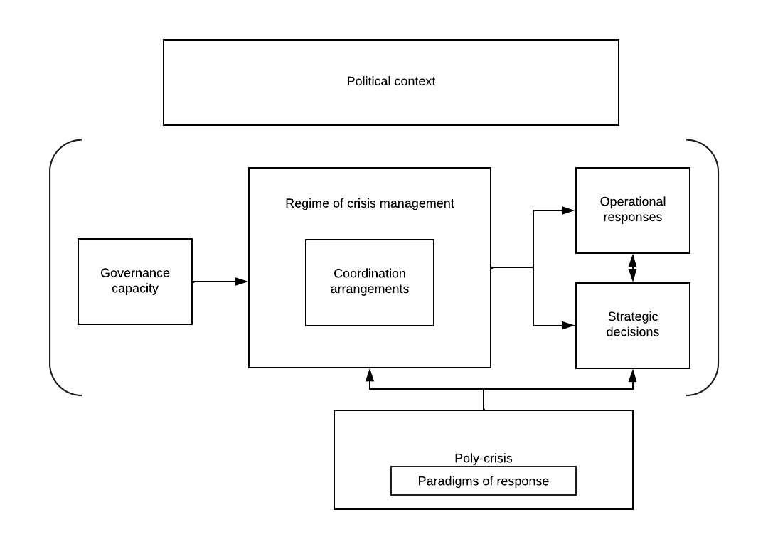
THEORETICAL APPROACH

Slide 6
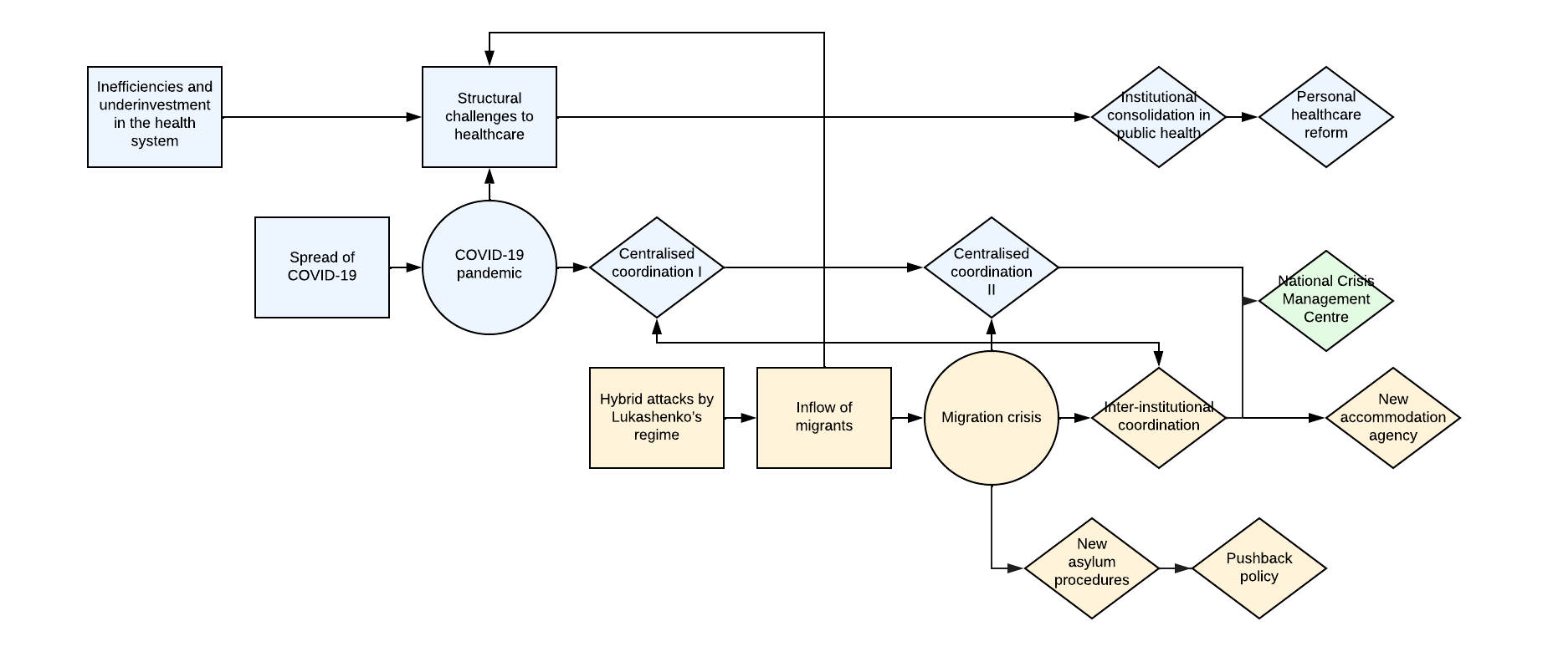
SPILLOVER EFFECTS
The spillover effects are the effects of individual crises that extend beyond the original scope and their policy field, thus affecting other domains and policy actors
Such spillover effects might increasingly strain the limited physical, financial or human resources of public sector organisations

Slide 7
EVENTS, DECISIONS AND SPILLOVER EFFECTS IN THE LITHUANIAN POLY-CRISIS

Slide 8
MECHANISMS OF CHANGE: COORDINATION AND POLICY RESPONSES
Governments follow standard procedures of crisis management (based on the logic of appropriateness), unless the existing crisis severely amplifies/accelerates or a new major crisis emerges in the scenario of negative crisis dynamics
In this situation, it is likely that governments will make their responses based on the logic of consequentiality, encompassing the reform of crisis management particularly through stronger centralisation and enhanced inter-institutional cooperation
But the continued evolution of complex systems can be shaped by interdependence and non-linear interactions among its elements (based on complexity theory and the ‘emergence’ idea)
Policy responses depend on prevailing paradigms of change:
- strategies of suppression and migitation with regard to COVID-19
- rights-based approaches vs pushback policies to migrants
Depending on the crisis and its political context, response strategies could de-politicised (learning pathway) or politicised (exploitation pathway) (Boin and Hart 2022)

Slide 9
NEW CRISIS AND EMERGENCY MANAGEMENT MODEL
Political–strategic level
Government
Prime Minister
National Security Commission
Government Office
Decision-making/coordination level
National Crisis Management Centre
Ministries and other state institutions
Joint Situation Centre
Operational-tactical level
Municipalities

Slide 10
CAUSAL CONFIGURATIONS EXPLAINING THE RESULTS OF INDIVIDUAL CRISES
Crisis | Independent variables |  | Intermediate variables |  | Dependent variables
 | Crisis events and paradigms | Political context | Governance capacity | Coordination arrangements | Main operational responses | Main strategic decisions
The COVID-19 pandemic | Four waves of the pandemic (with the strategies of suppression and mitigation) | Change of government at the end of 2020, political tensions between the ruling majority and opposition | Limited governance capacity to apply the mitigation strategy during the surge of COVID-19 cases | Centralised coordination from the centre of government from March 2020 to December 2020; from July 2021 to May 2022 | Networks of laboratories and hospitals, additional funding for the management of the disease, etc. | The consolidation of public health institutions; the adoption of a major healthcare reform; the establishment of the National Crisis Management Centre
Illegal migration | Sudden and major increase of illegal migrants crossing the border (rights-based approach vs migrant pushbacks) | No change of government, initial political consensus followed by some disagreements | Limited capacity to register migrants and process their asylum requests, as well as to provide accommodation and other social services | Inter-institutional coordination from November 2021 to May 2023 | A new policy of pushing back migrants, amending the asylum procedures | Building a physical barrier; the establishment of the National Crisis Management Centre; the establishment of a new agency for accommodation

Slide 11
PRELIMINARY CONCLUSIONS (ON COORDINATION)
Overall, both Lithuanian governments led by Prime Ministers Skvernelis and Šimonytė initially attempted to rely on existing arrangements and standard routines to manage the individual crises, in line with the logic of appropriateness. However, as these approaches proved to be ineffective, it became necessary to urgently develop new solutions for crisis management
In response to the new reality, the Lithuanian authorities created the separate system of managing the COVID-19 crisis in 2020 and the special arrangement to coordinate the crisis of illegal migration in 2021. They eventually led to the creation of the integrated system for crisis and emergency management in 2022. This highlights a shift to the logic of consequentiality, as well as the development of a new crisis management system emerging from the individual crises and their interaction
More specifically, our research results also confirm our expectations that during major and/or multiple crisis events that spill into other domains, governments not only tend to adopt a centralised approach to crisis management but also to develop joint and integrated solutions for crisis management

Slide 12
OTHER PRELIMINARY FINDINGS: NEW GOVERNANCE PRACTICES
New forms of coordination and collaboration (Nohrstedt et al., 2018) facilitated through networks and stakeholder engagement: to a large extent
Agile or adaptive management methods (Janssen and van der Voort, 2020) employed to respond promptly to rapidly changing situations: to a large extent
Governments can also embrace emerging technologies and new information solutions to drive innovation (De Nigris et al., 2020): to a large/moderate extent (depending on a policy area/individual state institutions and their capacities)
Public sector organisations can integrate such practices of anticipatory governance as strategic foresight (OECD, 2019): to a little extent (with policy actors drawing their lessons from the ongoing crises)
The Migration Department “has acquired the ability to swiftly establish reception and registration centres, rapidly mobilise supplementary resources and create new positions”

Slide 13
Thank you for the attention!
tspmi.vu.lt
/company/tspmi
Vitalis Nakrošis, professor (vitalis.nakrosis@tspmi.vu.lt)
/tspmi
/vu_tspmi
/VUTSPMI

